Slide 1
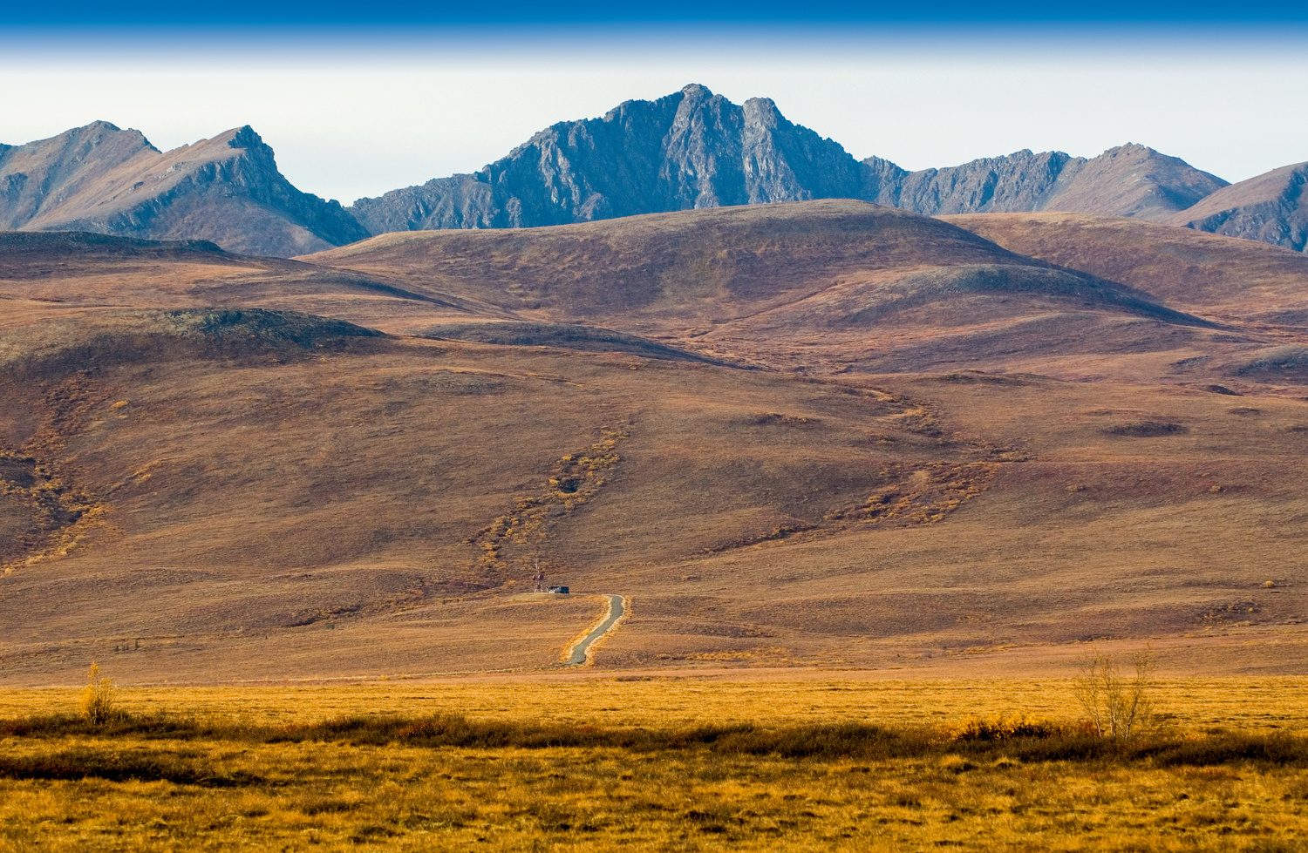
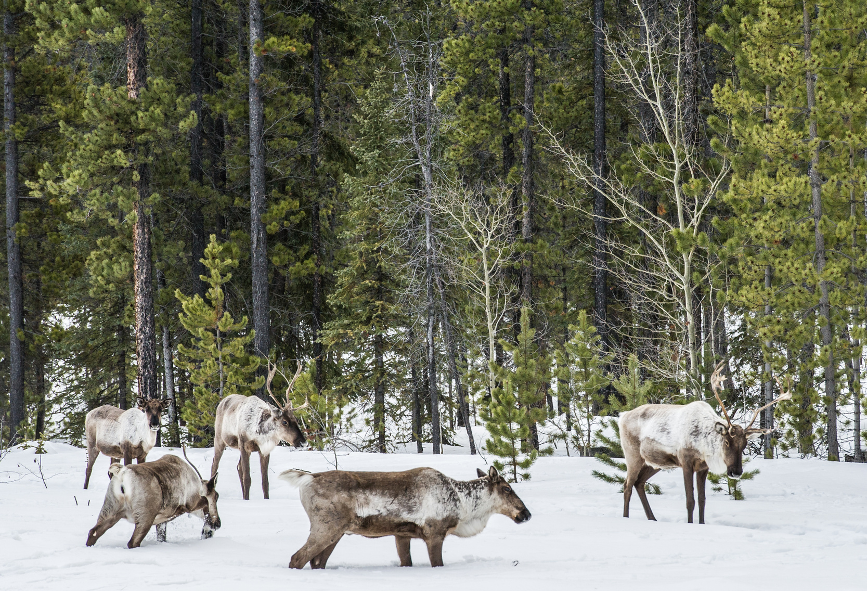
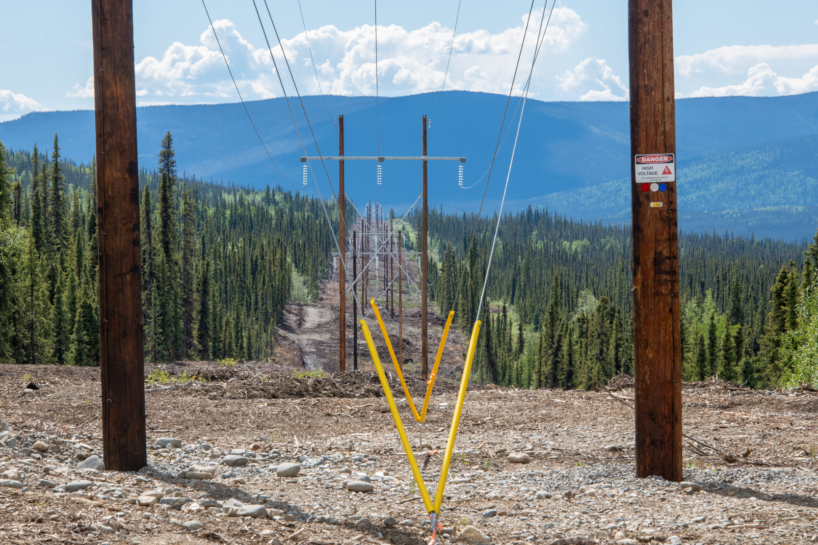

YESAA – 101
For Public
Notes:
1

Slide 2
YESAA and its Origin
  YESAA stands for the “Yukon Environmental and Socio-economic Assessment Act”. It was passed on May 13, 2003 and came into effect on November 28, 2005.
  YESAA was developed as a requirement under the Development Assessment chapter (12) of the Umbrella Final Agreement (UFA) and each Yukon First Nation’s Final Agreement.
  The Council of Yukon First Nations (CYFN), Canada and the Government of Yukon (the Parties) crafted the legislation and regulations together. The CYFN relied on input from all Yukon First Nations.
  YESAA is a “made-in-Yukon” law, designed to meet the needs of Yukon First Nations and Yukoners. It is unlike other assessment legislation throughout Canada because it is guided by specific Treaty objectives.
  YESAA establishes the Yukon Environmental and Socio-Economic Assessment Board (YESAB) as an independent, arms-length body that is responsible for carrying out environmental and socio-economic assessments.
Notes:
2

Slide 3
YESAA: A federal legislation
  YESAA is federal legislation that applies in the Yukon.
  In 1993, the UFA was signed by the Parties (Canada, Yukon and CYFN). It required “Government” to create development assessment legislation. (UFA s.12.3.0).
  The UFA defined “Government” to mean “Canada or the Yukon, or both, depending on which government or governments have responsibility, from time to time, for the matter in question”.
  Chapter 12 of UFA – Development Assessment sets out the process for conducting environmental and socio-economic assessments of projects before they occur.
  In 1993 only Canada had responsibility to conduct environmental assessments in the Yukon under the Canadian Environmental Assessment Act (CEAA).
  The Parties negotiated the Yukon Environmental & Socio-economic Assessment Act (YESAA) and it was passed by Parliament in May 2003.The Act replaced the Canadian Environmental Assessment Act in the Yukon.
Notes:
7

Slide 4
Purpose of YESAA
The purpose of YESAA as set out in section 2 of the Act:
a) To provide a comprehensive, neutrally conducted assessment process applicable in Yukon;
b) To require that, before projects are undertaken, their environmental and socio-economic effects be considered;
c) To protect and maintain environmental quality and heritage resources;
d) To protect and promote the well-being of Yukon First Nations persons and their societies and Yukon residents generally, as well as the interests of other Canadians;
e) To ensure that projects are undertaken in accordance with principles that foster beneficial socio-economic change without undermining the ecological and social systems on which communities and their residents, and societies in general, depend.
Notes:
8

Slide 5
Purpose of YESAA
f) To recognize and, to the extent practicable, enhance the traditional economy of Yukon First Nations persons and their special relationship with the wilderness environment;
g) To guarantee opportunities for the participation of Yukon First Nations persons– and make use of their knowledge and experience – in the assessment process;
h) To provide opportunities for public participation in the assessment process
i) To ensure that the assessment process is conducted in a timely, efficient and effective manner that avoids duplication; and
j) To provide certainty to the extent practicable with respect to assessment procedures, including information requirements, time limits and costs to participants.
Notes:
4

Slide 6

Assessment process under YESAA
Notes:
15

Slide 7
Rules and regulations
The Act has 2 accompanying regulations:
1. Assessable Activities, Exceptions and Executive Committee Projects Regulations
2. Decision Body Time Periods and Consultation Regulations
The UFA and YESAA set out the assessment process at a high level. This process is further specified in Rules established by the Board.
There are three sets of Board Rules:
•Designated Office Evaluations
•Executive Committee Screenings
•Panel Reviews by the Board

Slide 8
Three levels of assessment
  Regional – Designated Office Evaluations
The majority of assessments (%) are done in regional, community-based offices.
  Head Office – Executive Committee Screenings
The Executive Committee of the Board assesses larger projects that come to it directly, or are referred by a Designated Office.
  Board Level – Panel Reviews
Projects can be referred by the Executive Committee or, in certain circumstances, a review can be requested by the federal minister, territorial minister, or a First Nation.
Notes:
5

Slide 9
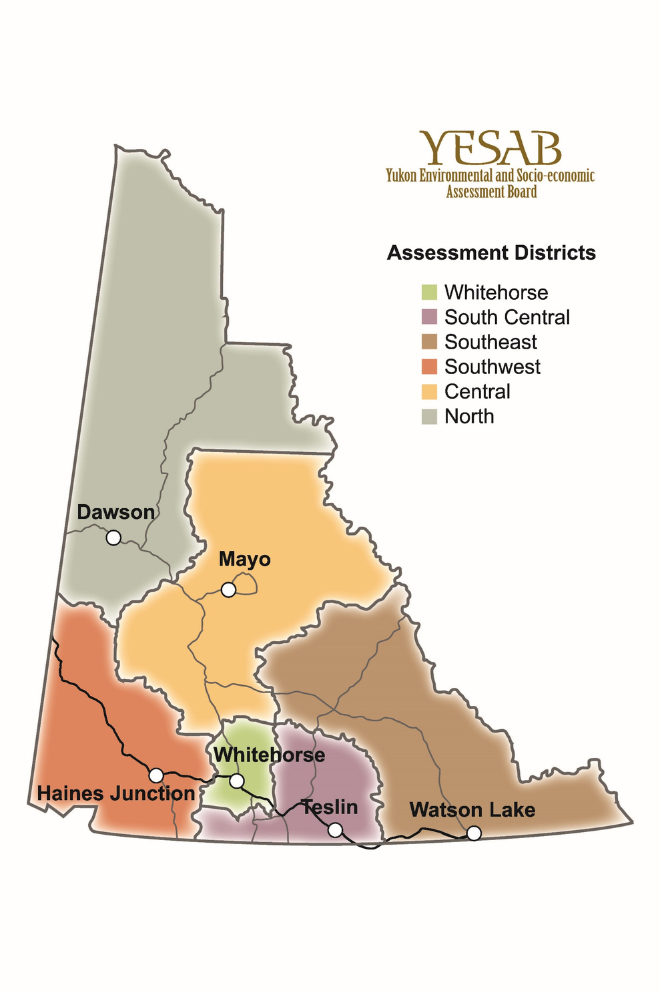
Regional Assessments
Notes:
17

Slide 10
What triggers an assessment?
•Activities that require an assessment are set out in the Assessable Activities Regulation.
•The regulation has 3 Schedules:
-Schedule 1: Activities and Specific Exceptions for Designated Office assessments
-Schedule 2: General Exceptions
-Schedule 3: Activities for Executive Committee Screenings
•Schedule 1 has 13 Parts which set out specific activities and exceptions. (see table)
Part 1- Mining | Part 2- Industrial Activities | Part 3- Oil & Natural Gas
Part 4- Energy & Telecommunications | Part 5- Wildlife | Part 6- Transportation
Part 7- Nuclear Facilities & Substances | Part 8- Contaminants | Part 9- Water
Part 10- Fisheries | Part 11- Air emissions | Part 12- National Parks and Historic Sites
Part 13- Miscellaneous
Notes:
9

Slide 11
What triggers an Assessment?
An assessment is required when the conditions of s.47(2) of the Act are met:
An activity that is listed in the regulation, and is not excepted, is subject to assessment if proposed to be undertaken in Yukon and if,
a)A federal agency is the proponent;
b)A territorial agency, municipal government, or first nation is the proponent and an authorization or the grant of an interest in land would be required for the activity to be undertaken by a private individual;
c)An authorization or the grant of an interest in land by a government agency, municipal government of first nation is required for the activity to be undertaken; or
d)An authorization by the Governor in Council is required for the activity to be undertaken.
Notes:
12

Slide 12
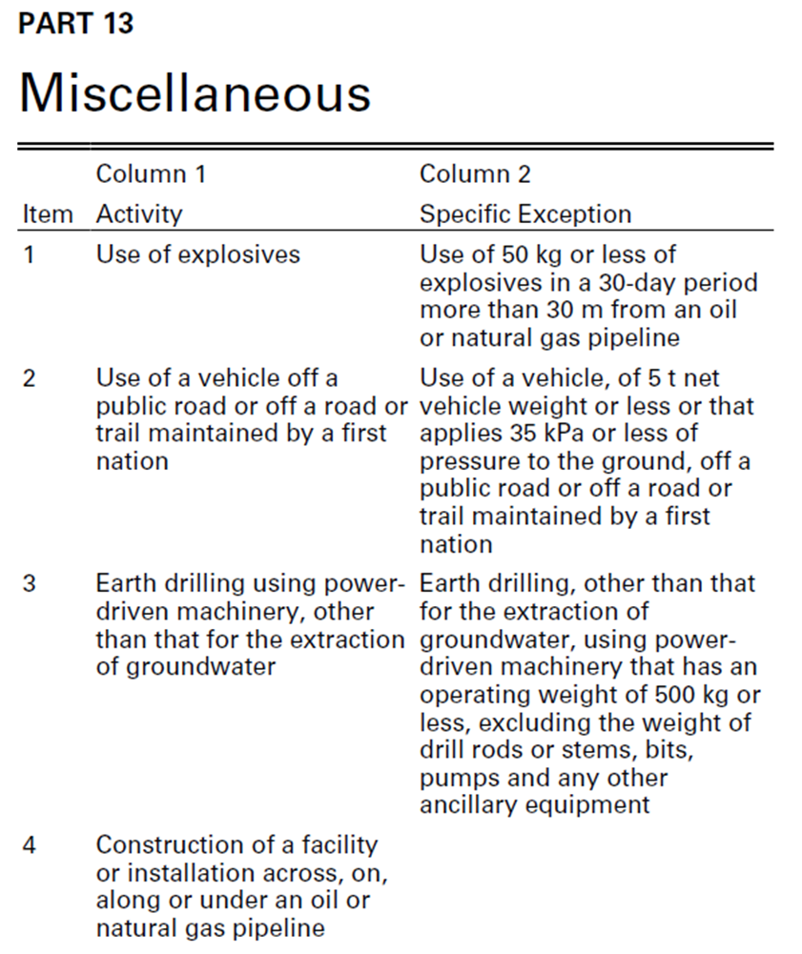
Assessable Activities Regulation: Example
Notes:
11

Slide 13
Matters to be Considered
There are specific matters to be considered in an assessment as set out section 42(1) of the Act:
In conducting an assessment of a project, a designated office, the executive committee or a panel of the Board shall take the following matters into consideration:
a)The purpose of the project;
b)All stages of the project;
c)The significance of any environmental or socio-economic effects of the project that have occurred or might occur in or outside the Yukon, including the effects of malfunctions or accidents;
d)The significance of any adverse cumulative environmental or socio-economic effects that have occurred or might occur in connection with the project in combination with the effects of other projects for which proposals have been submitted or any activities that have been carried out, are being carried out or are likely to be carried out in or outside the Yukon
d.1) Any studies or research undertaken under s.112(1) that are relevant to the project;
    d.2) the need for effects monitoring;
Notes:
14

Slide 14

YESAA- Consultation
Consultation is defined in s.3 of YESAA
Where, in relation to any matter, a reference is made in this Act to consultation, the duty to consult shall be exercised
a)By providing, to the party to be consulted,
i.Notice of the matter in sufficient form and detail to allow the party to prepare its own views on the matter,
ii.A reasonable period for the party to prepare its views, and
iii.An opportunity to present its views to the party having the duty to consult; and
b)By considering, fully and fairly, any view so presented.
Notes:
1.7.2013
16
‹#›

Slide 15
YESAA- Consultation
•Proponent obligation to consult potentially affected FNs and community residents prior to the screening is set out in YESAA (s50(3)).
•Crown (federal and territorial governments) – has a separate and distinct constitutional duty to consult affected First Nations on projects.
•Federal and territorial governments may choose to rely on the YESAA process to fulfill elements of their constitutional duty to consult with First Nations.
•YESAB Neither YESAB or the EC, has the duty or authority to conduct consultation with First Nations affected by a proposed project.
Notes:
27

Slide 16
Assessment Timelines & Reports
The timelines of assessments are subject to Board rules and can be extended depending on nature of the project and requests for more time from participants. Current project statistics with timelines are available at yesabregistry.ca/statistics
The assessment and YESAB’s recommendation is contained in a report as below:
  Designated Office – Evaluation Report
  Executive Committee – Screening Report
  Panel of the Board – Panel Report
Notes:
23

Slide 17
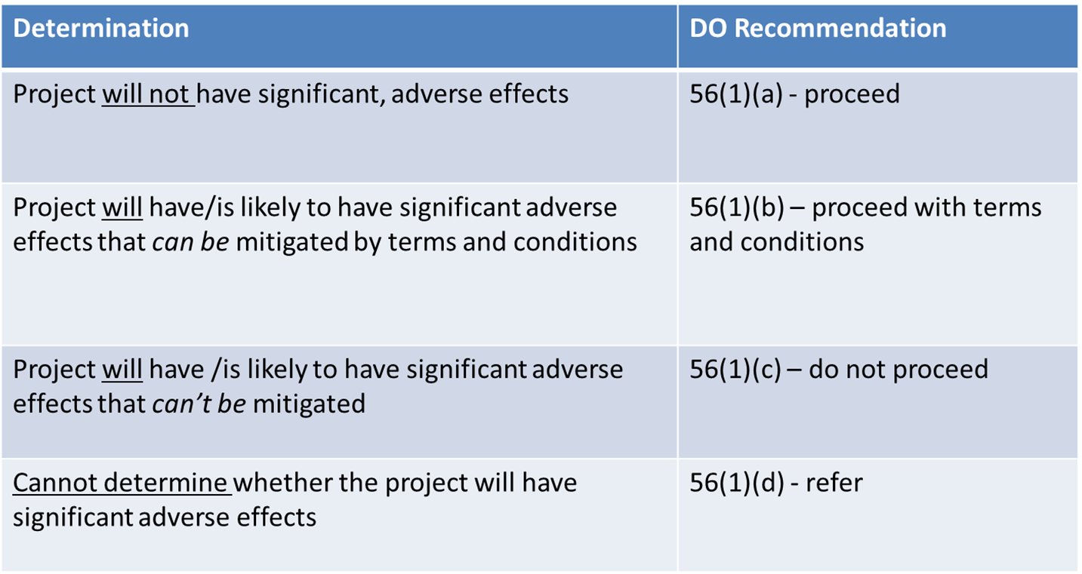
Assessment Recommendations
Notes:
23

Slide 18
Assessment Decision -- Governments
Decision Maker (called Decision Bodies) - YG, FN or Canada (government) must
    Accept,
    Vary, or
    Reject
Assessment Recommendation in a public decision document
Reasons must be given if varied or rejected
Notes:
26

Slide 19
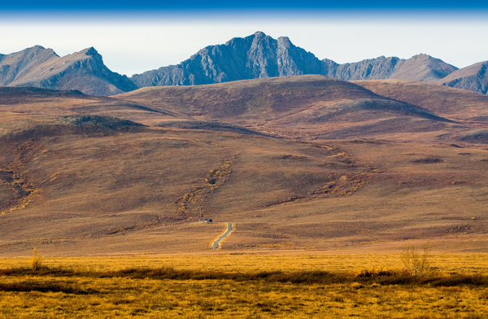




For more information, visit:
Website: www.yesab.ca
YESAB Online Registry : www.yesabregistry.ca
Call: 668-6420 Toll Free: 1-866-322-4040
Fax: 867-668-6425
Email: yesab@yesab.ca
Notes:
1.7.2013
23
‹#›

