Slide 1
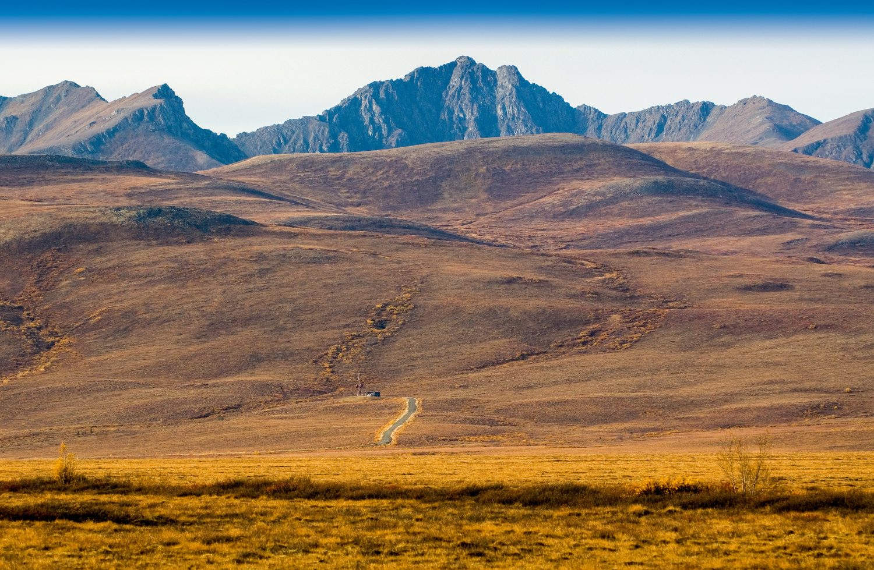

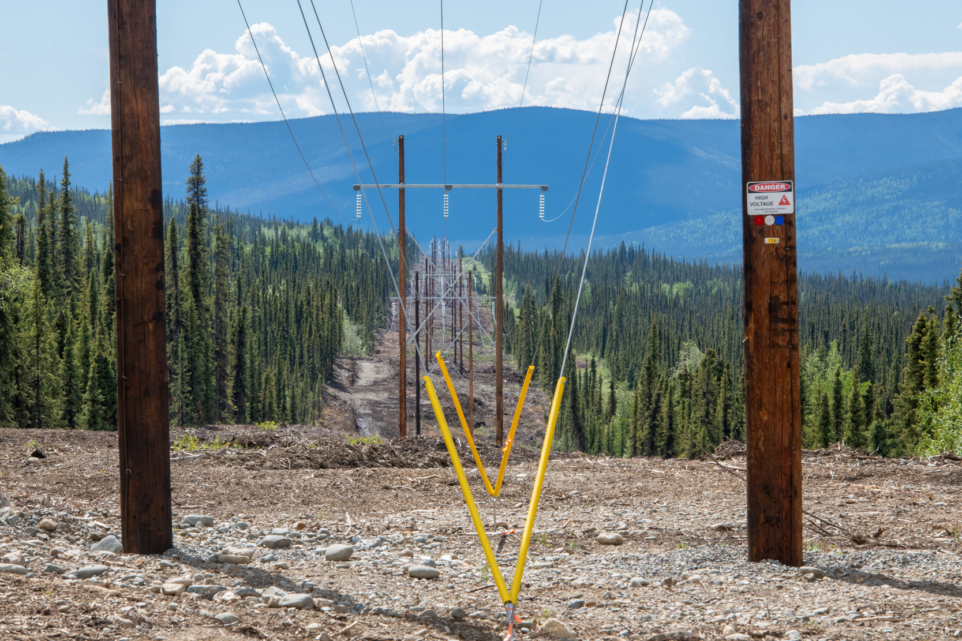

YESAB – 101
For Public
Notes:
1

Slide 2
What is YESAB?
  Yukon Environmental and Socio-economic Assessment Board is an independent Board established under the Umbrella Final Agreement and YESAA legislation in 2003.
  YESAB conducts environmental and socio-economic assessments of projects before they are considered by the governing body.
  YESAB’s purpose, on behalf of all Canadians, is to conduct neutral assessments in the Yukon that contribute to protecting the environment and the social, economic, and cultural well-being of First Nations and residents.
Notes:
2

Slide 3
Origin of YESAB
  YESAA that stands for the “Yukon Environmental and Socio-economic Assessment Act” came into full effect on November 28, 2005.
  YESAA was developed as a requirement under the Development Assessment chapter of the Umbrella Final Agreement (UFA) and each Yukon First Nation’s Final Agreement.
  The Council of Yukon First Nations (CYFN), Canada and the Government of Yukon (the Parties) crafted the legislation and regulations together. The CYFN relied on input from all Yukon First Nations.
  YESAA is a “made-in-Yukon” law, designed to meet the needs of Yukon First Nations and Yukoners. It is unlike other assessment legislation throughout Canada because it is guided by specific Treaty objectives.
  YESAA establishes YESAB as an independent, arms-length body that is responsible for carrying out environmental and socio-economic assessments.

Slide 4
YESAB Values
  Regard for Our Origins – We have a special relationship with the Umbrella Final Agreement and the unique environmental and socio-economic assessment legislation that it created. We recognize that we are one of many with a role to play in meeting its spirit and intent.
  Truth and Reconciliation – We are committed to establishing and maintaining a mutually respectful relationship between Indigenous and non-Indigenous peoples in Canada by implementing the Truth and Reconciliation Commission’s calls to action.
  Accountability – We are responsible to meet our commitments to each other and participants to deliver a comprehensive environmental and socio-economic assessment process.
  Respect for Everyone –There is no room for intolerance, racism, discrimination, or barriers for involvement in the work we do or how we do it.
Notes:
7

Slide 5
YESAB Values
  Curiosity – We are inspired by other ways of learning about the world we live in and how our work is challenged, explained, and conveyed.
  Learning Together – We share and invite diverse skills, talent, and knowledge in support of a culture of enthusiasm and caring for each other.
  Relationships – We strengthen relationships by welcoming diverse perspectives, building trust, and respectful dialogue.
  Communication – We share information and rationale for our recommendations and engage in ways that help us understand one another.
Notes:
8

Slide 6
The Board
YESAB’s Seven-Person Board is appointed by the Government of Canada based on nominations from the Council of Yukon First Nations, Yukon government and the federal government.
  Chair
  2 Executive Committee Members
  4 Board Members
Notes:
4

Slide 7
Appointments to the Board
  Prior to the appointments, nominations to the Board are made as specified in the legislation (YESAA).
  One member of the Executive Committee is nominated by the Council of Yukon First Nations (CYFN) and one member is nominated by the territorial government. The third member of the Executive Committee, the Chair, is appointed after the federal minister consults with the other two Executive Committee members.
  Of the four remaining Board members, two are nominated by CYFN, one is nominated by the territorial government and the fourth is a direct appointment by the federal minister.

Slide 8

The Staff
  Executive Director
  Management Team
  Designated Office Managers
  Assessment and Admin Staff
Head Office:
Suite 200-309 Strickland Street
Whitehorse, Yukon
Y1A 2J9
Designated Offices: Dawson, Haines Junction, Mayo, Teslin, Watson Lake, Whitehorse
Notes:
5

Slide 9

What Does YESAB Do?
  We assess the potential adverse environmental or socio-economic effects of proposed projects.
  We issue a recommendation that the proposed project can proceed, proceed with conditions or cannot proceed.
  The decision maker (governments) makes a decision to accept, vary or reject the recommendation.
Notes:
9

Slide 10
Where Does YESAB Fit?
Proponent: Proposal
YESAB: Assessment
Decision Body: Decision Document
Regulators: Authorizations
Proponent: Construction, Operation & Closure
Government: Compliance & Monitoring
Notes:
10

Slide 11

What YESAB does not do
  We are not a regulator
  We are not part of any government department or branch
  We do not make final decisions on projects
  We do not issue permits, licences or authorizations
  We do not enforce permits
Notes:
11

Slide 12

Assessment Stats
Number of Completed Assessments (2005 – 2023)
    3,463 projects
    Average number per year - 272 projects
Type of Assessment:
    Designated Office Evaluation - 99.7% (3,446 completed)
    Executive Committee Screening - 0.3% (11 completed, 4 active)
    Panel Review 0% (1 active)
Notes:
12

Slide 13
Assessments by District 2005-2023
Notes:
13

Slide 14
Projects by Sector

Slide 15
Assessment Outcomes
Notes:
Decision by Decision Body 2023
Accepted Recommendation – 49%
Varied Recommendation – 51%
Rejected Recommendation – 0%

Slide 16

How do YESAB assessments work?
Notes:
15

Slide 17

Three levels of assessment
Regional: Designated Office Evaluations
The majority of assessments (%) are done in regional, community-based offices
Head Office: Executive Committee Screenings
The Executive Committee of the Board assesses larger projects that come to it directly, or are referred by a Designated Office
Board Level: Panel Reviews
Panels of the Board are established to assess projects that may cause major public concern and are referred to it by the Executive Committee.
Notes:
1.7.2013
16
‹#›

Slide 18
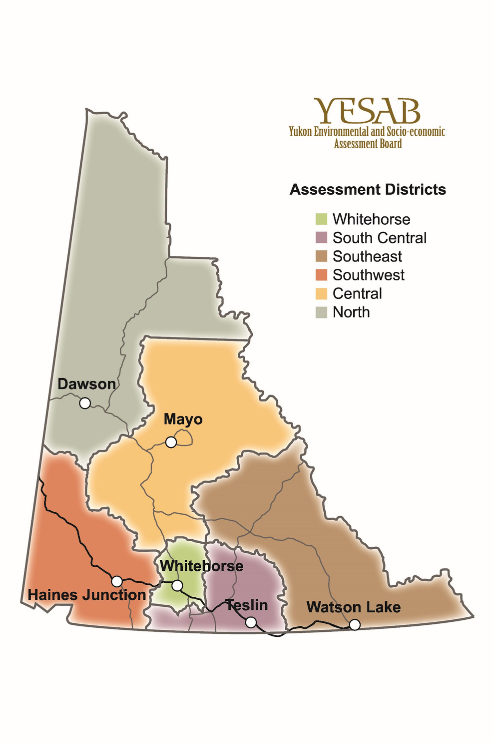
Regional Assessments
Notes:
17

Slide 19
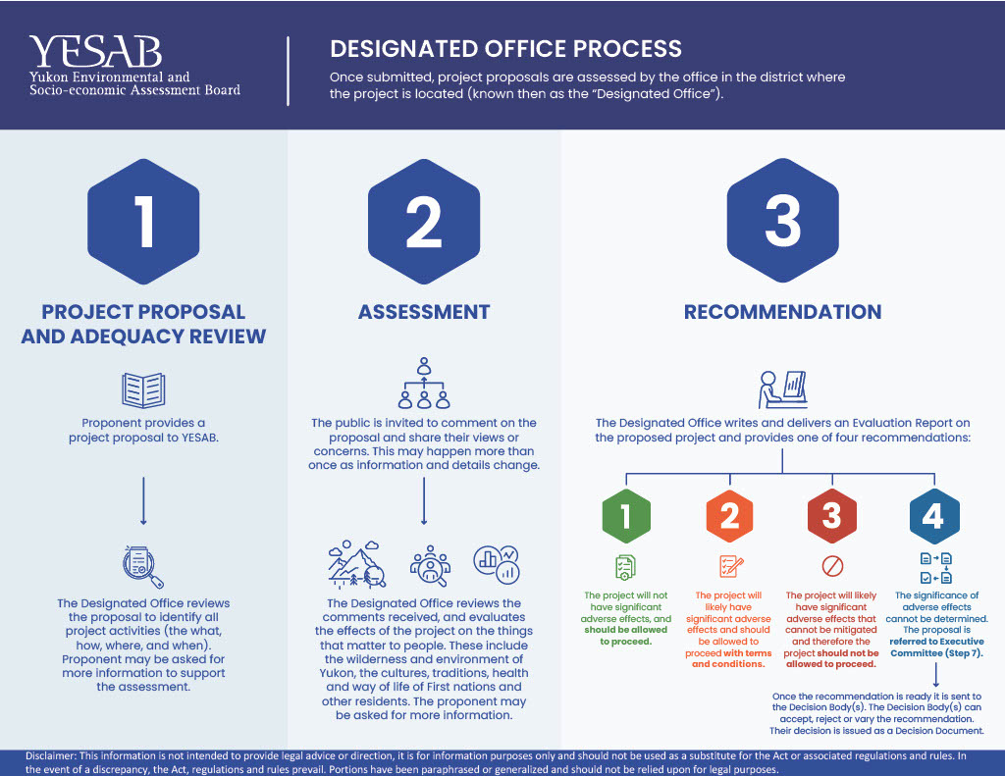
Notes:
18

Slide 20
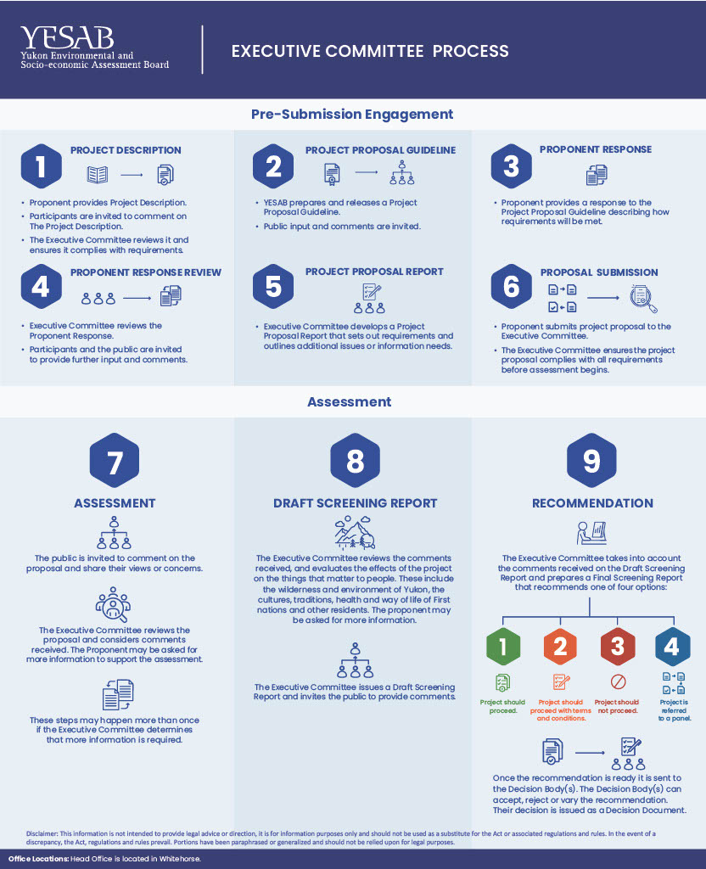
Notes:
19

Slide 21
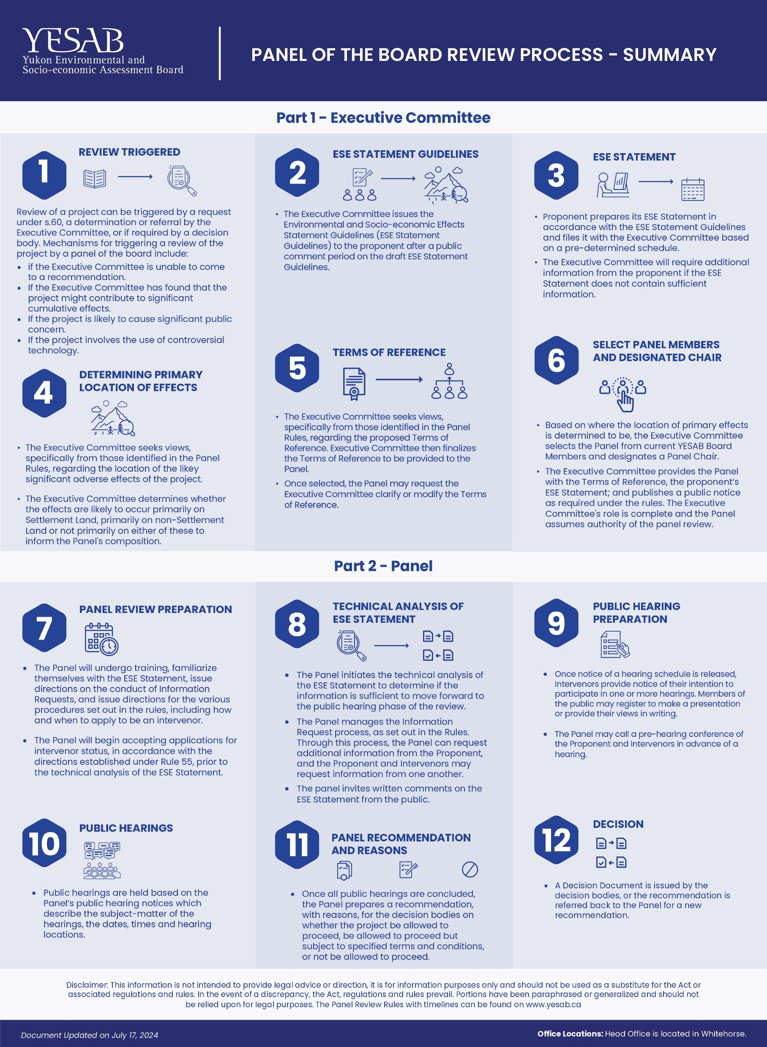

Slide 22
YESAB’s Methods – How We Do Our Work
Governed by:
  Act, Regulations
  Board Rules
  Policies & Guidelines
  Impact Assessment Methodology
Notes:
27

Slide 23
Assessment Recommendation
YESAB issues a Recommendation that the project can:
  proceed,
  proceed with conditions,
  cannot proceed,
  or is referred to a higher level of assessment
Notes:
27

Slide 24
Assessment Reports
The assessment and YESAB’s recommendation is contained in a report as below:
  Designated Office – Evaluation Report
  Executive Committee – Screening Report
  Panel of the Board – Panel Report
Notes:
23

Slide 25
Assessment Decision -- Governments
Decision Maker (called Decision Bodies) - YG, FN or Canada (government) must
    Accept,
    Vary, or
    Reject
Assessment Recommendation in a public decision document
Reasons must be given if varied or rejected
Notes:
26

Slide 26

Public Participation in Assessments

Slide 27
Public Participation in Assessments
Public Participation: seeking views, YESAB Online Registry
YESAA : Guaranteed Participation of First Nations
- Provide opportunities for public participation
Comments can be submitted in various ways:
    YESAB Online Registry
    Person
    Phone
    Mail
    Email
Notes:
1.7.2013
17
‹#›

Slide 28
YESAB Online Registry - YOR
HOW TO FIND A PROJECT OF INTEREST AND SUBMIT COMMENTS
  YESAB’s process is about the people, the land and resources.
  Every project assessment includes a public comment period.
  During this period, everyone has an opportunity to review project information and provide comment and views to an assessment.
Notes:
21

Slide 29
YESAB Online Registry - YOR
STEPS:
  To find a project proposal and make comments, search using the YOR's advanced search function by project location, title, assessment district, proponent name etc.
  You can request to be notified about projects of interest by hitting the 'Follow' button.
  Comments can either be submitted anonymously or with a name by creating a profile on YESAB Online Registry.
  Apart from YESAB Online Registry, you can also submit comments by calling, visiting or sending a mail or e-mail to a YESAB office.
Notes:
21

Slide 30
How to Prepare Effective Comments
  A key part of assessments under YESAA is the guaranteed opportunity for First Nations, individuals and groups to provide comments on projects being assessed.
  Comments submitted to an assessment should outline the values that are relative to the environment and the health and well-being of people and provide explanation as to how these things may be affected by a proposed development.
Notes:
22

Slide 31
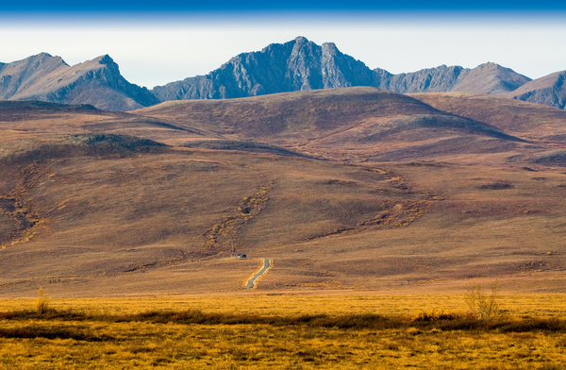




For more information, visit:
Website: www.yesab.ca
YESAB Online Registry : www.yesabregistry.ca
Call: 668-6420 Toll Free: 1-866-322-4040
Fax: 867-668-6425
Email: yesab@yesab.ca
Notes:
1.7.2013
23
‹#›

